Slide 1
Improving performance of movie recommendation systems using multi criteria input and supervised learning
‹#›
Team Members Group No: 76
Project Advisor : Dr. C. Selvi, Assistant Professor, CSE
Co -Guide: Vidhya S., Assistant Professor, CSE
S.No | Reg.No | Name of the Student | Section
1 | CB.EN.U4CSE16303 | A.S.S.S. RAM CHANDU | D
2 | CB.EN.U4CSE16304 | ADVAITH M.S. | D
3 | CB.EN.U4CSE16323 | GOPIKRISHNA K.S. | D
4 | CB.EN.U4CSE16448 | PAVITHRAN S. | E
Date: 07-07-2019
Group No: 76
Notes:
‹#›

Slide 2
Outline
‹#›
Introduction
Problem Statement
Existing methods summary
Findings
Software Architecture
Results
References
Date: 07-07-2019
Group No: 76

Slide 3
Introduction
‹#›
Recommender systems is a subclass of information filtering system that seeks to predict the "rating" or "preference" a user would give to an item. They are primarily used in commercial applications.
Recommender systems are one of the most common and easily understandable applications of big data.
Generate meaningful recommendations to a collection of users for items or products that might interest them
Convince users to try or buy an item
Increase the users satisfactions
Mathematical Representation of Recommender Systems
C = Users
S = Recommendable items
U = Utility Function
For each user c (c ∈ C), choose the items s(s ∈ S) that maximize u.
s’_{c} = argmax_{u}u(c,s) ∀c ∈ C
Date: 07-07-2019
Group No: 76

Slide 4
Problem Statement
‹#›
To improve the performance of recommendation systems by transforming collaborative filtering into techniques of supervised learning, include more features namely timestamp, user demographics(gender, occupation, zip code), compare different models and impact of feature inclusion.
Date: 07-07-2019
Group No: 76

Slide 5
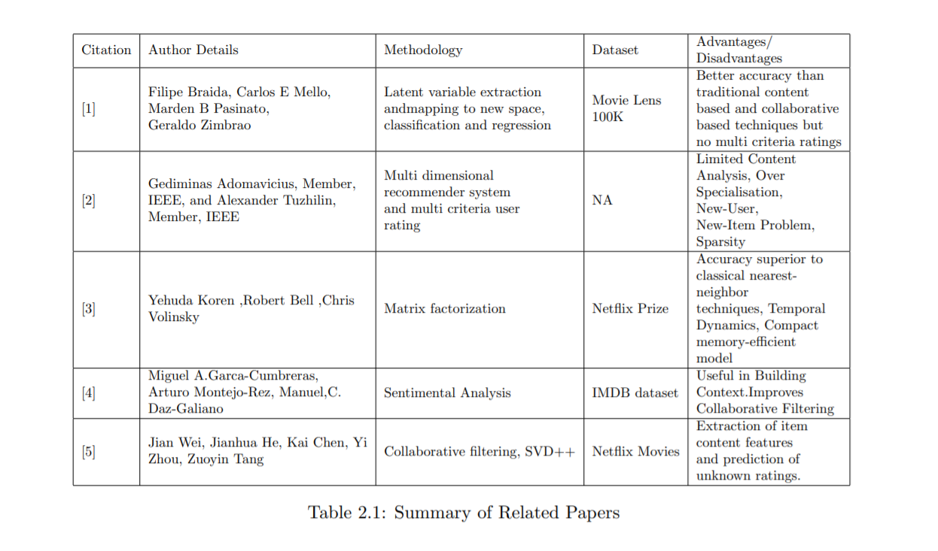
Existing Methods Summary
Date: 07-07-2019
Group No: 76

Slide 6
Findings
‹#›
In the current paper , they have a proposed a methodology to transform the CF scheme into a SL scheme through the construction of an input feature space based on the latent variables extracted from the rating matrix.
Their results were compared with Artificial Neural Networks , Naive Bayes classifiers and Random Forest.
Not only that , their method also reduces the rating prediction error for classes with few observation.
Their experiments were conducted all off-line and they haven’t used it on online recommender system scenarios.
The proposed method also didn’t consider the features associated with users such as demographic data and user opinions and sentiments.
Date: 07-07-2019
Group No: 76

Slide 7
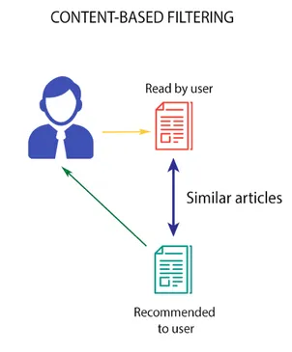
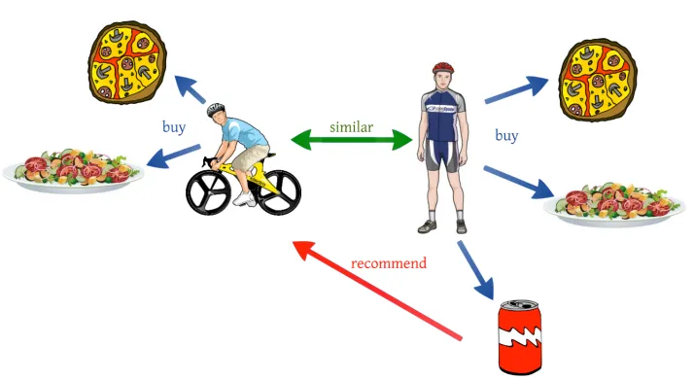
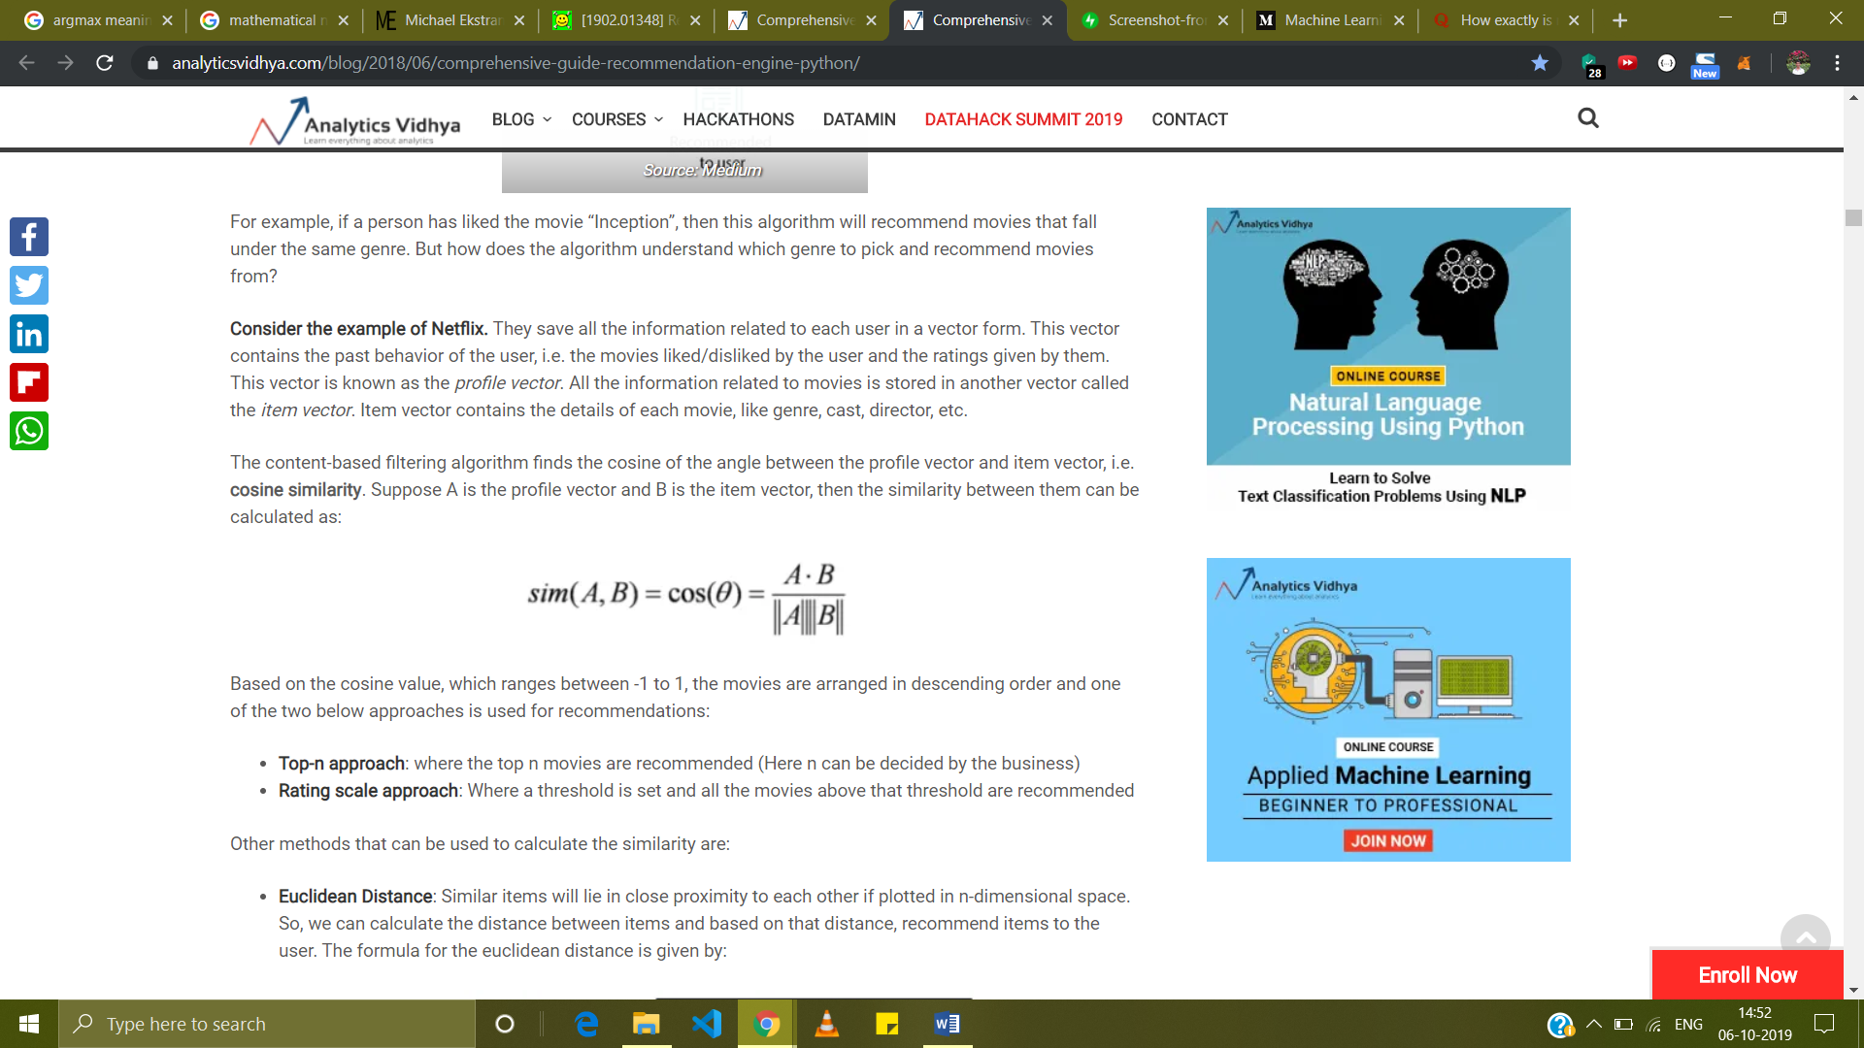
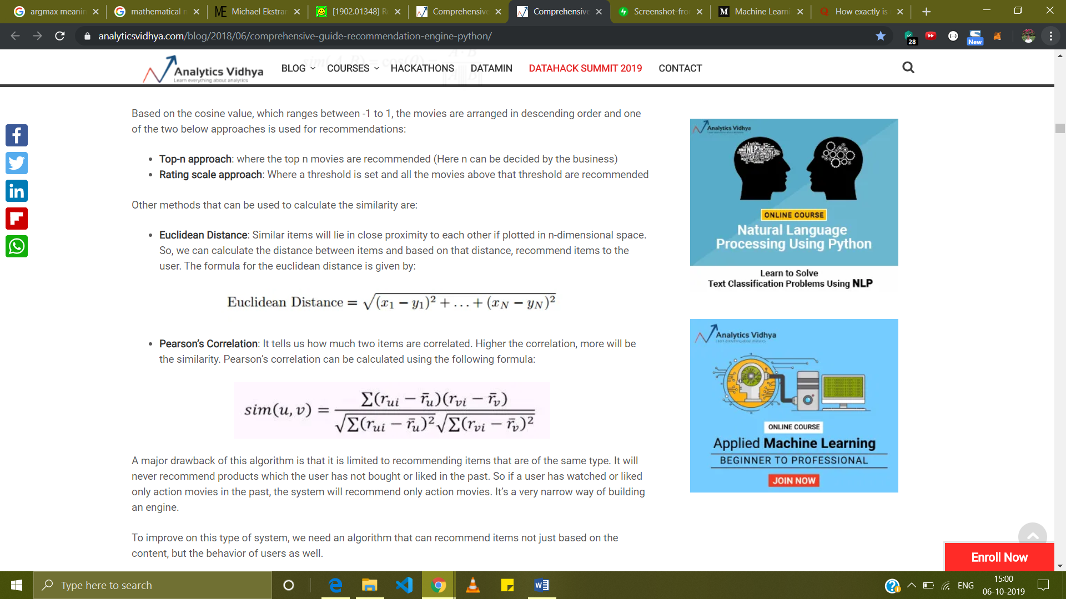

Findings
‹#›
User-User Collaborative filtering
Cosine Similarity
Euclidean distance
Pearson’s correlation
Date: 07-07-2019
Group No: 76

Slide 8
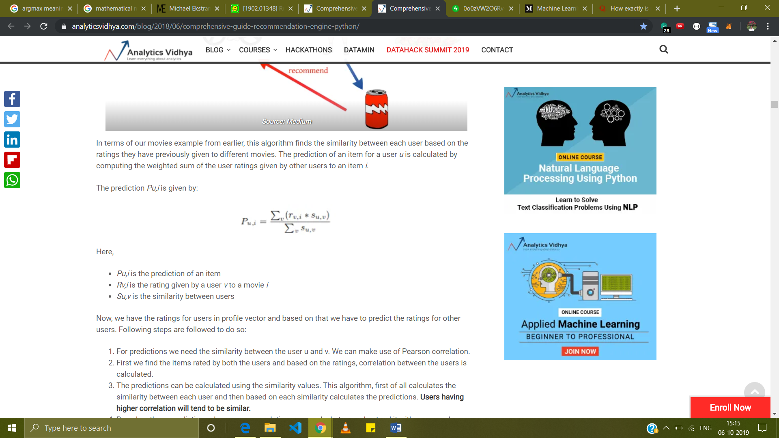


Findings
‹#›
USER-USER COLLABORATIVE FILTERING
It is proven in the base paper that using supervised learning provides better accuracy than these techniques
Date: 07-07-2019
Group No: 76

Slide 9
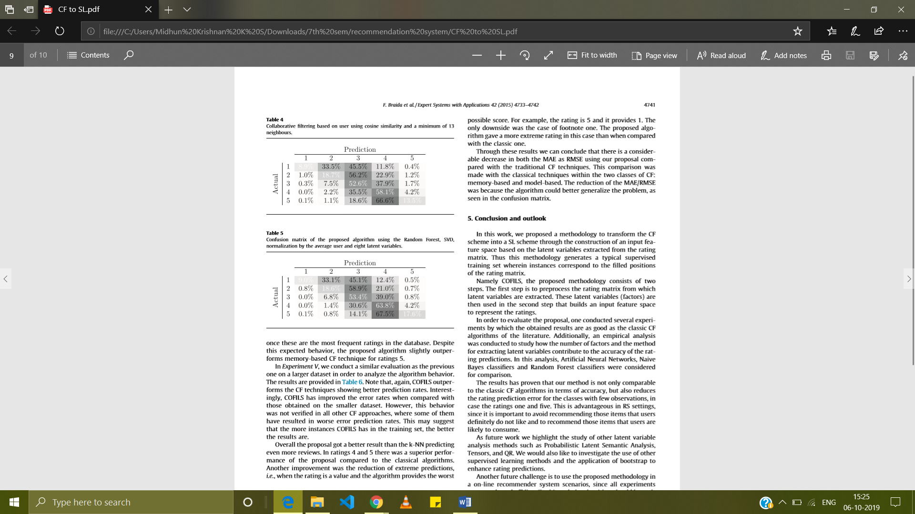
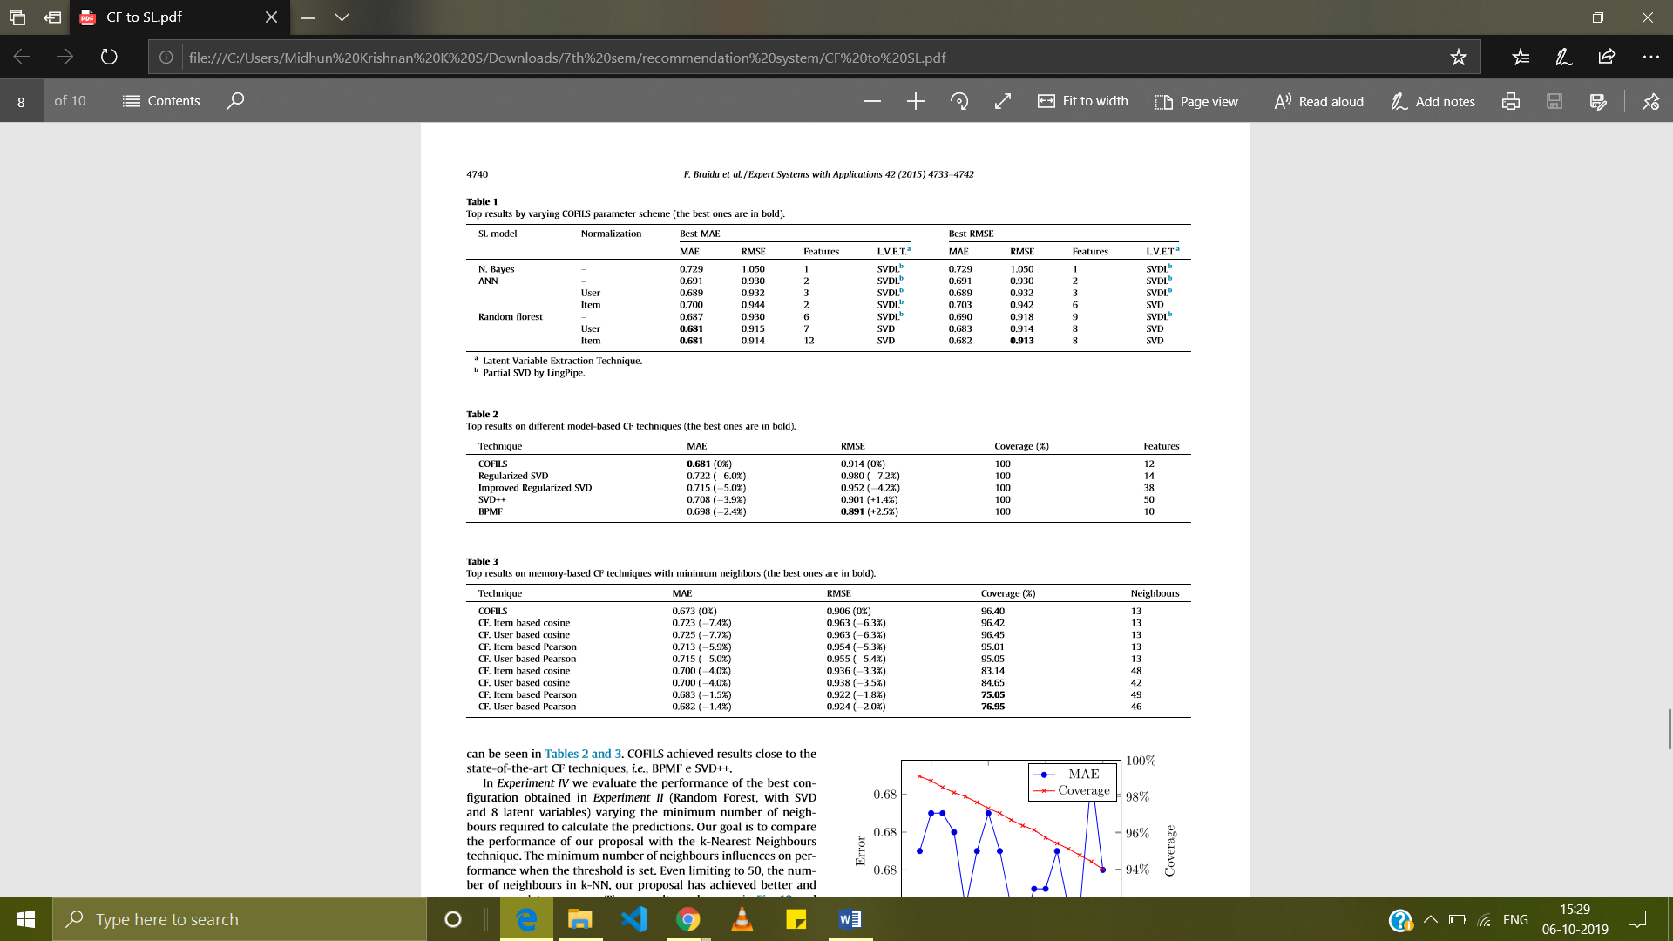
Findings
‹#›
It is proven in the base paper that using supervised learning provides better accuracy than these techniques
Date: 07-07-2019
Group No: 76

Slide 10
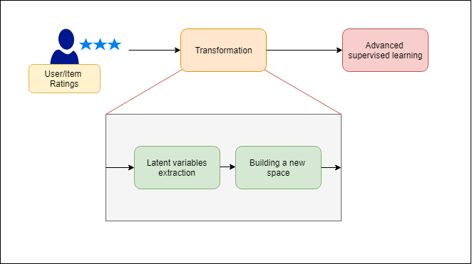
Software Architecture
‹#›
Flow diagram of procedure in base paper
Date: 07-07-2019
Group No: 76

Slide 11
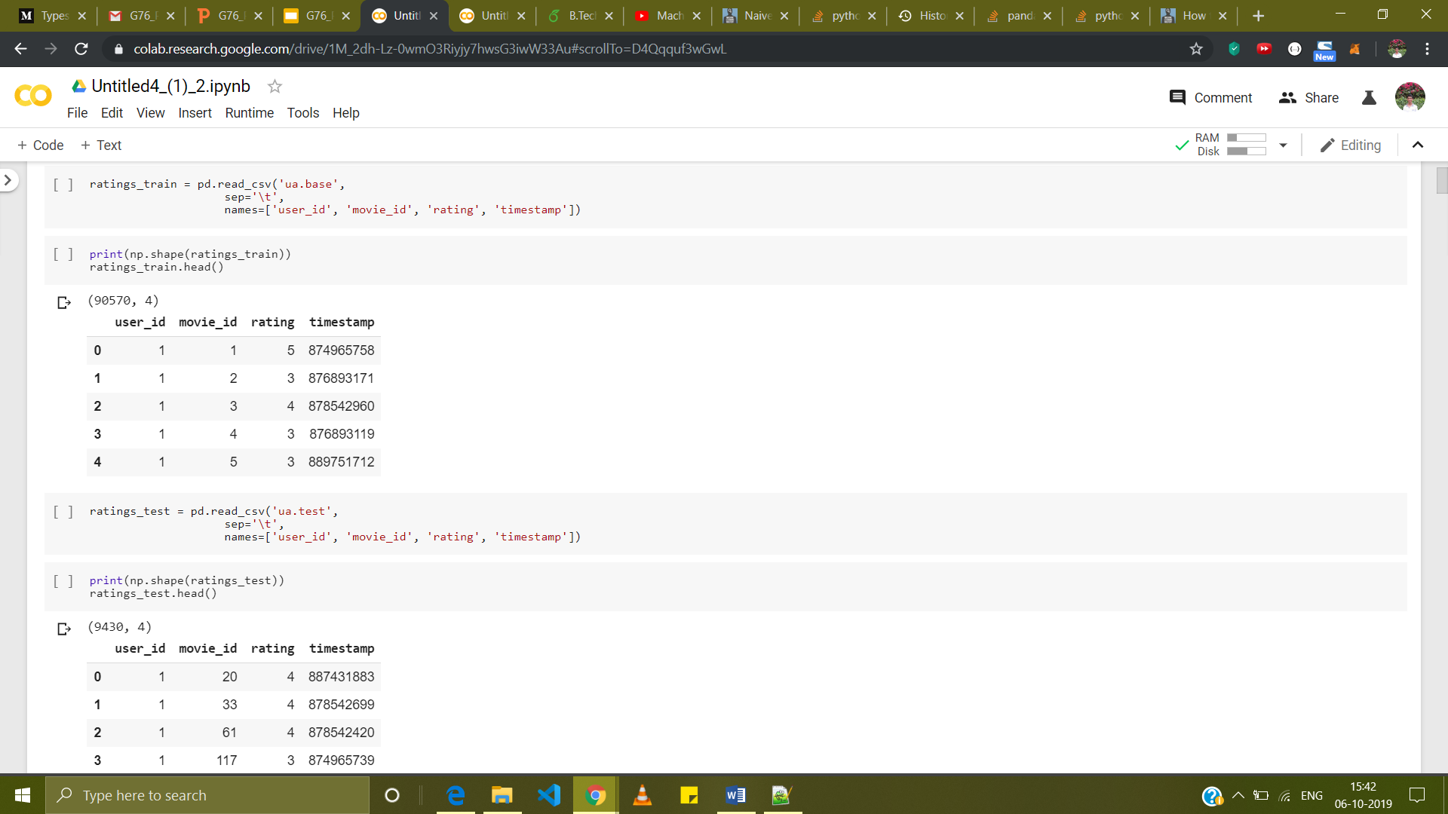
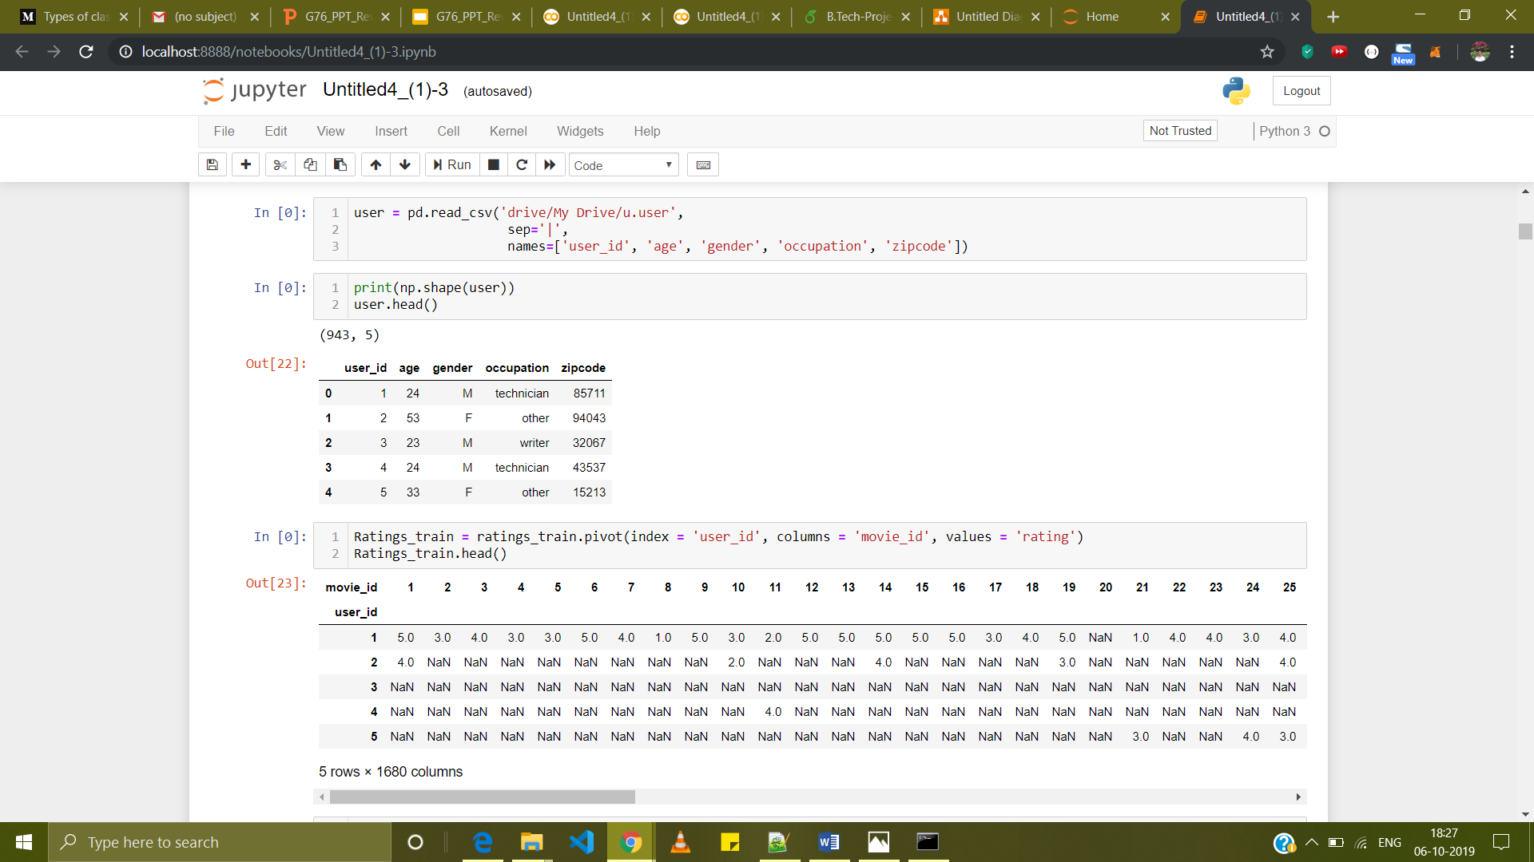
Software Architecture
‹#›
Dataset:The full u data set, 100000 ratings by 943 users on 1682 items. Each user has rated at least 20 movies. Users and items are numbered consecutively from 1. The data is randomly ordered. The time stamps are unix seconds since 1/1/1970 UTC. The model also uses demographic information about the users.
Screenshot of input dataframe sample
Screenshot of demographic information of users
Date: 07-07-2019
Group No: 76

Slide 12
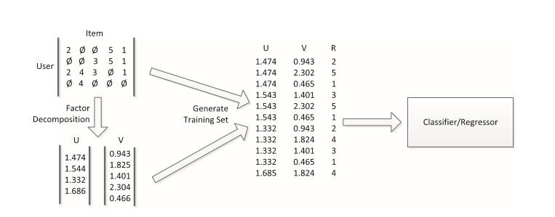
Software Architecture
‹#›
Procedure for transforming the collaborative filtering problem to supervised learning
Date: 07-07-2019
Group No: 76

Slide 13
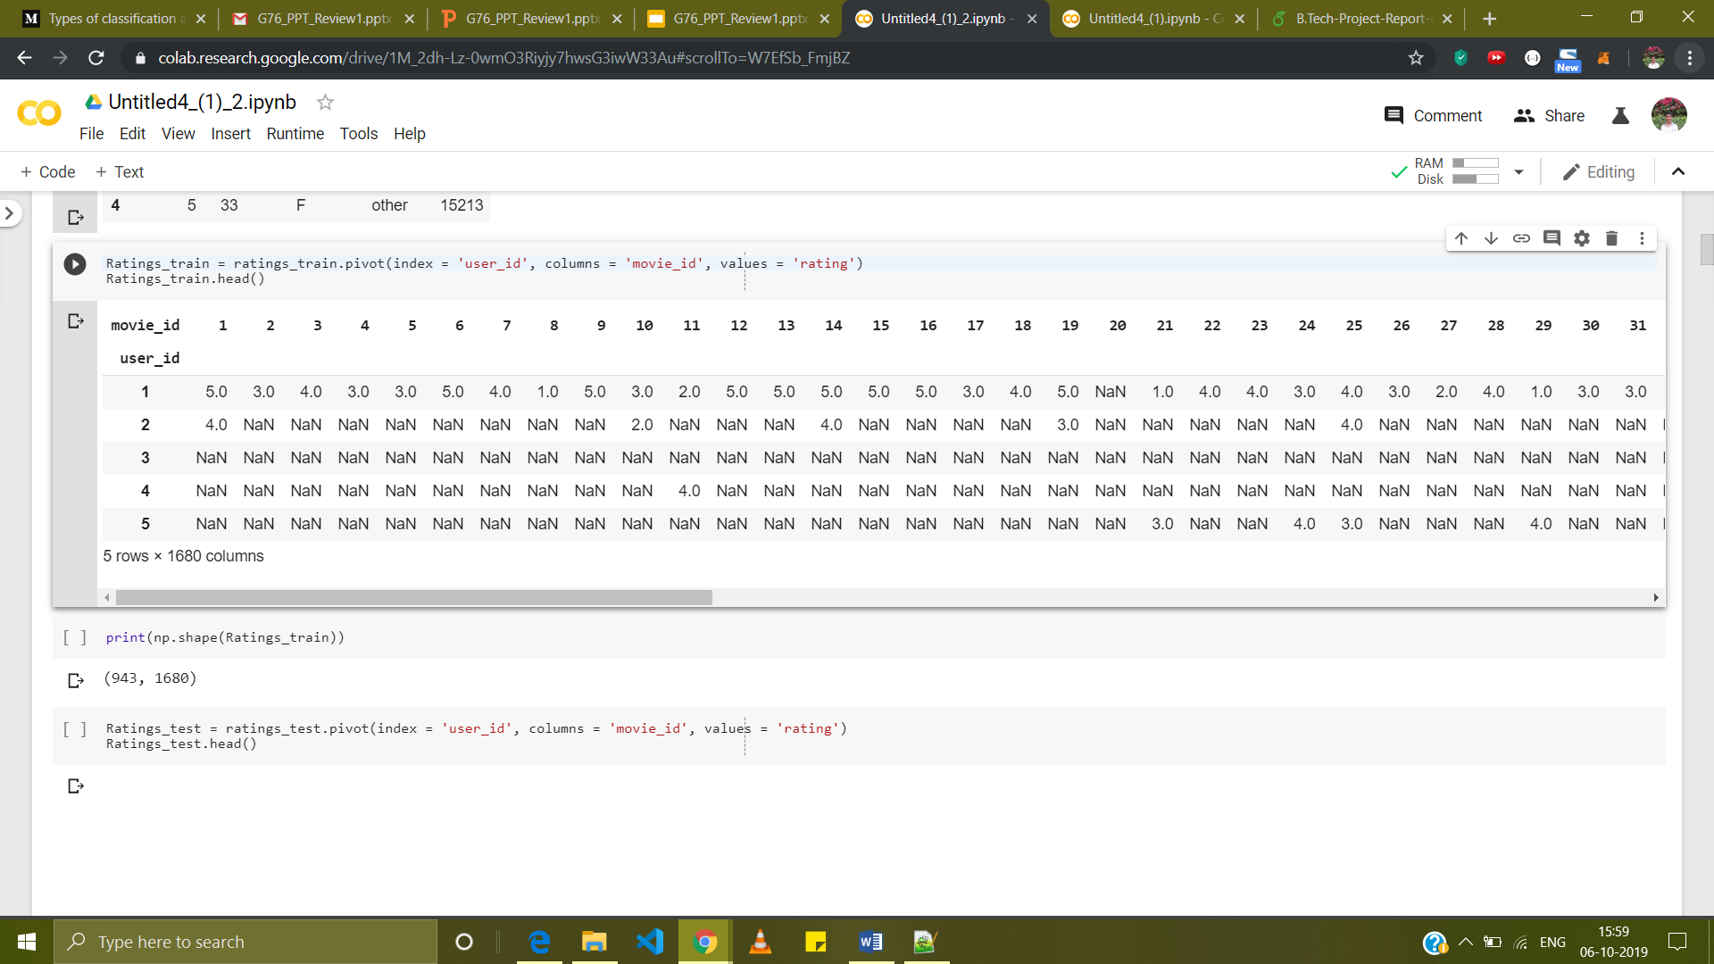
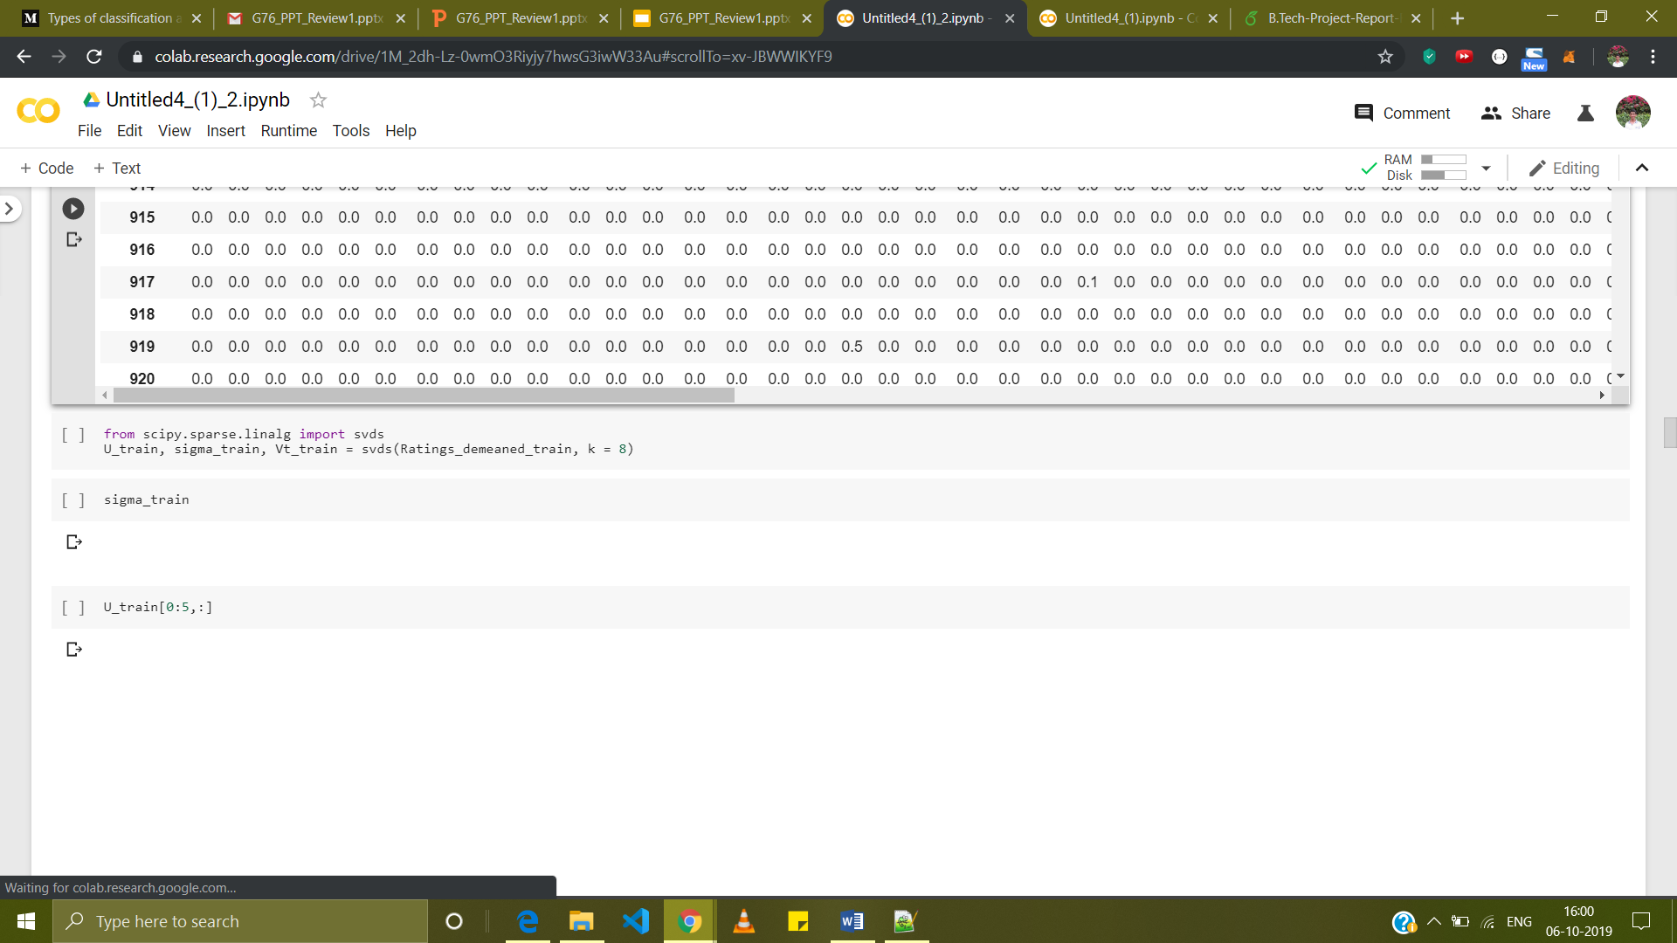
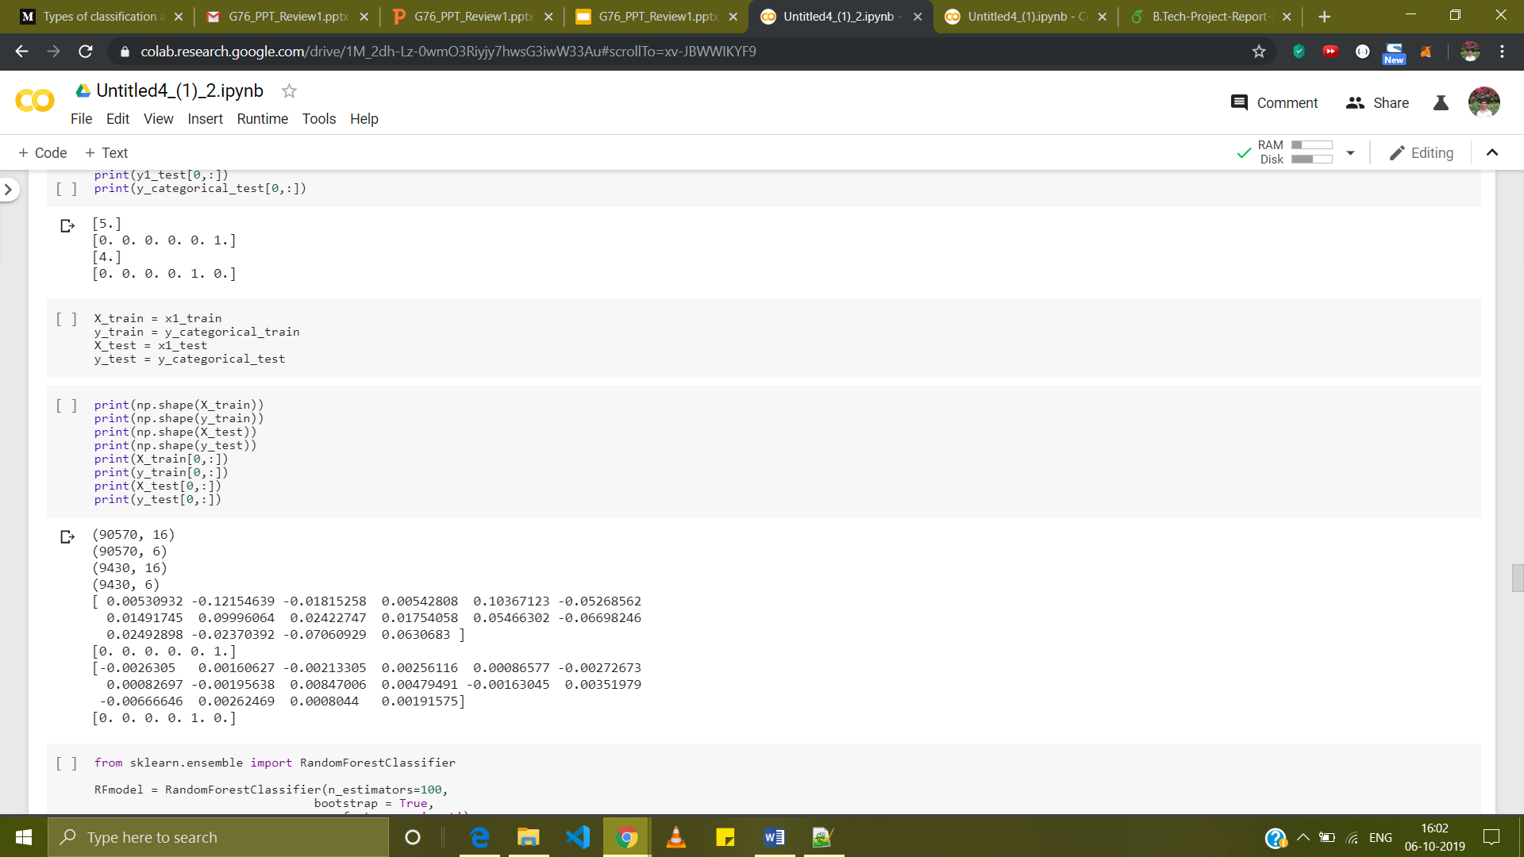
Software Architecture
‹#›
Input matrix after pivoting such that rows represent users and columns represent movies
Input matrix after Singular Value Decomposition and taking the first eight latent variables
Date: 07-07-2019
Group No: 76

Slide 14
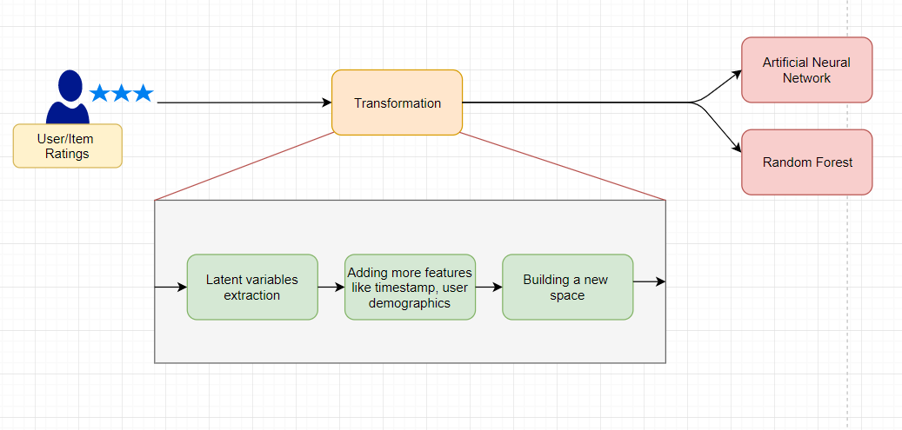
Software Architecture
‹#›
Flow diagram of procedure to improve accuracy of base paper
Date: 07-07-2019
Group No: 76

Slide 15
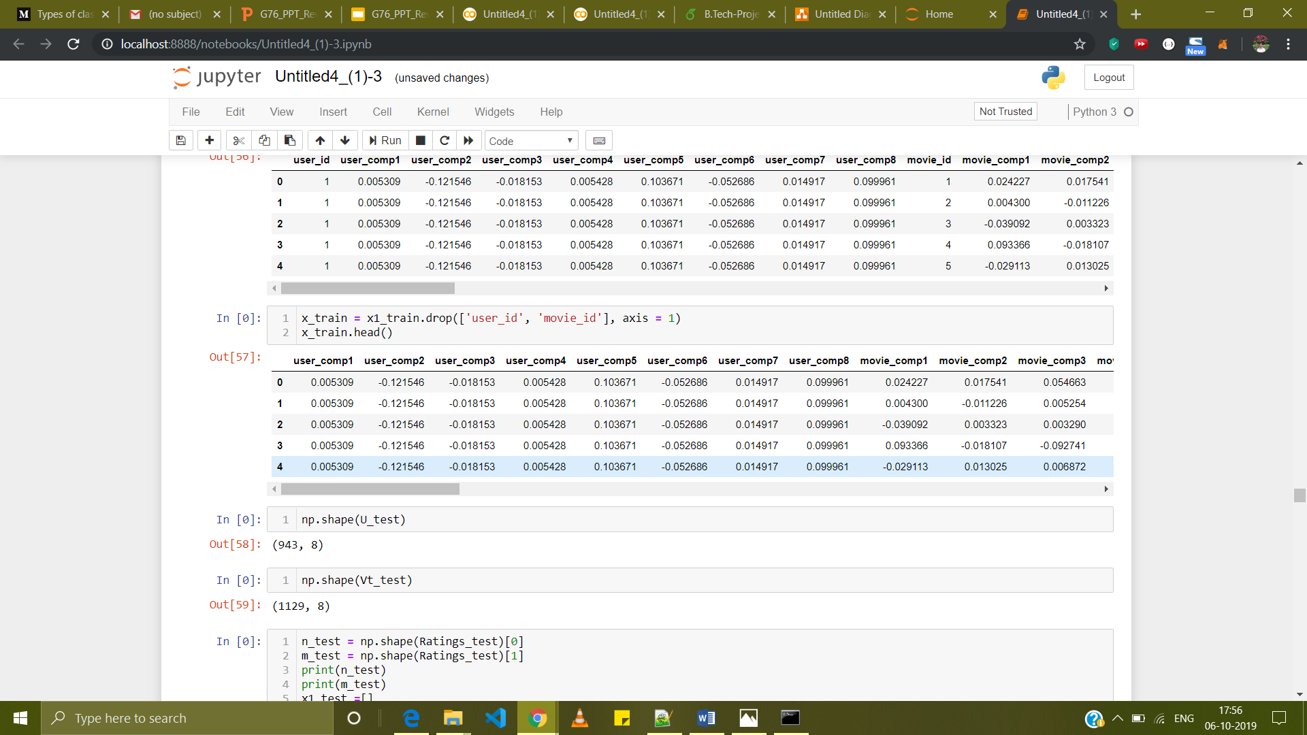
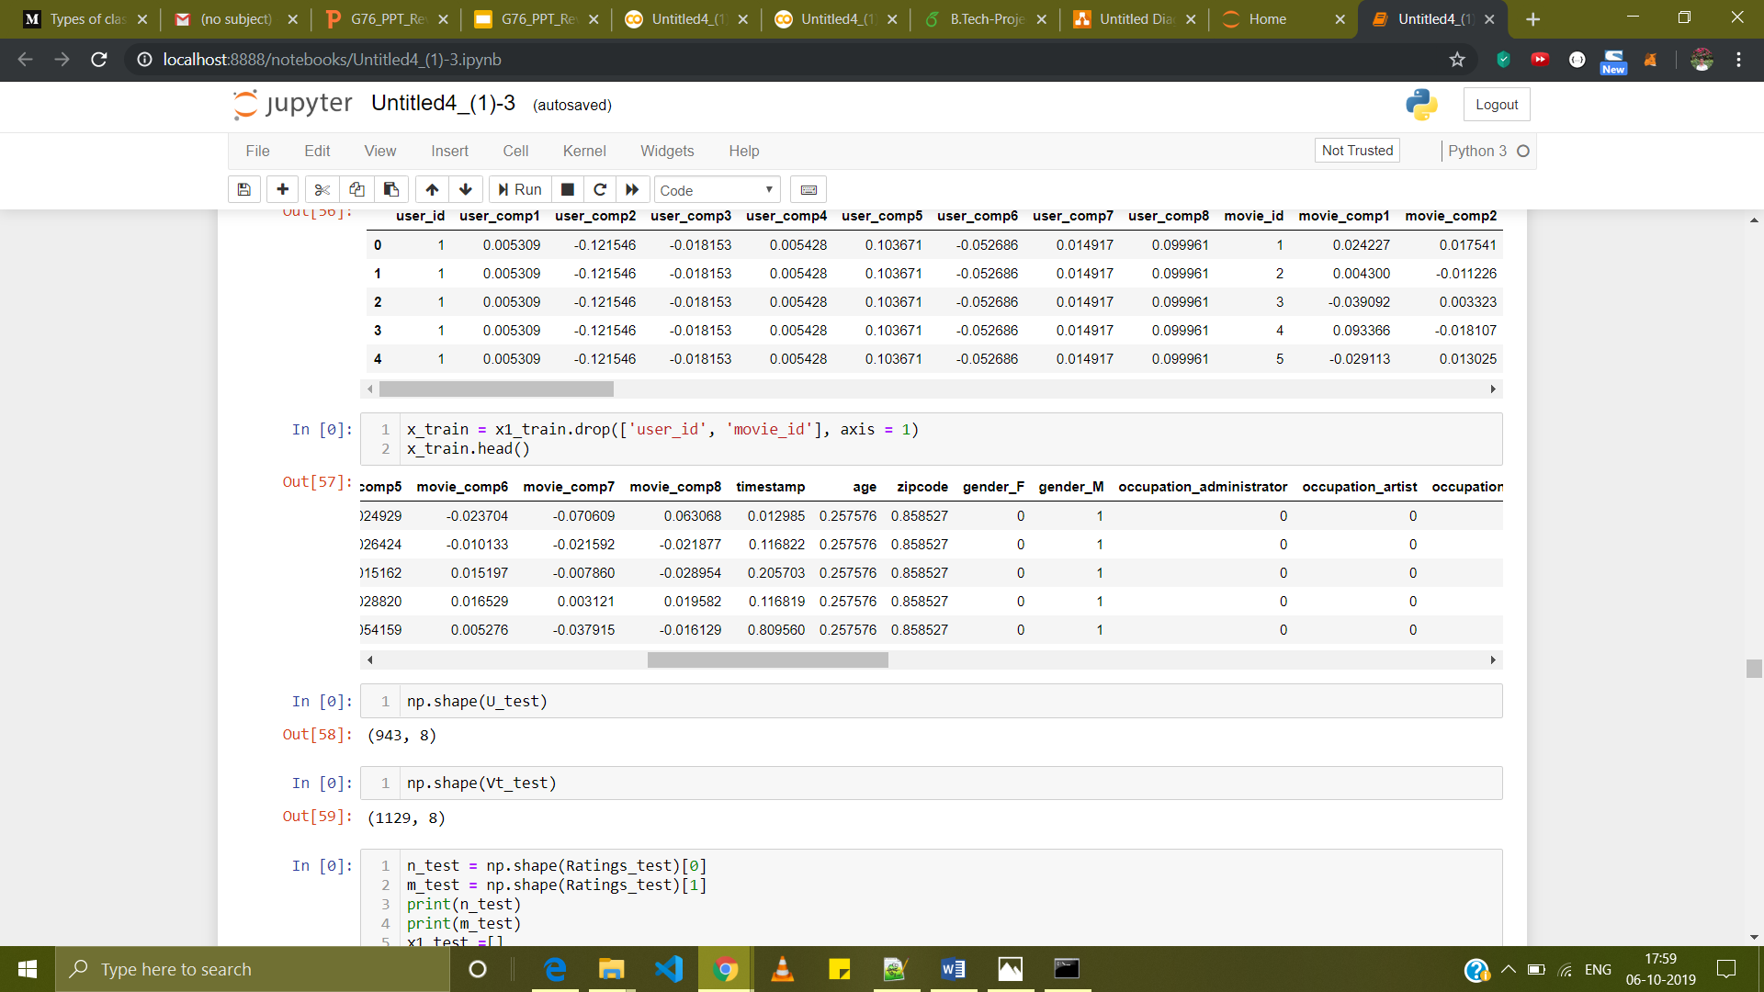
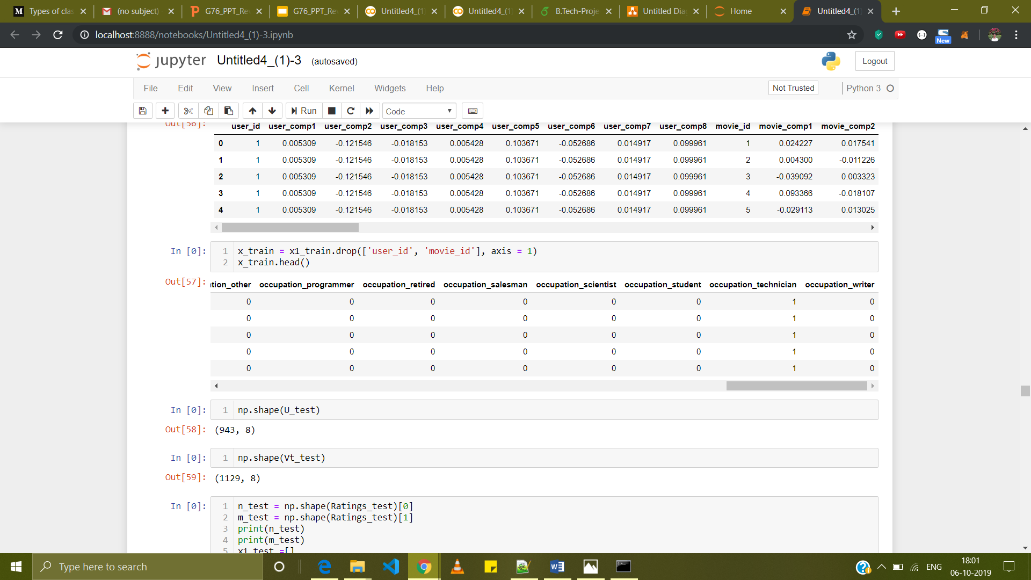
Software Architecture
‹#›
Date: 07-07-2019
Group No: 76

Slide 16
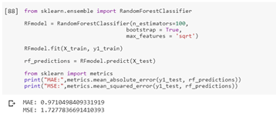
Results
‹#›
It is found that adding features like timestamp and user demographics like gender, age, zip code reduces the error in techniques namely random forests, and artificial neural network as clear from the screenshots below.
Date: 07-07-2019
Group No: 76

Slide 17
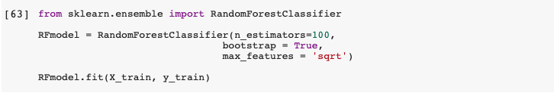
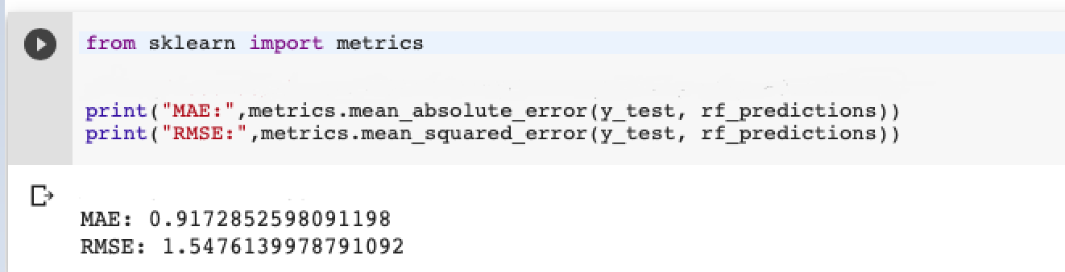
Results
‹#›
Date: 07-07-2019
Group No: 76

Slide 18
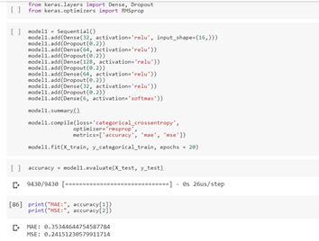
Results
‹#›
Date: 07-07-2019
Group No: 76

Slide 19
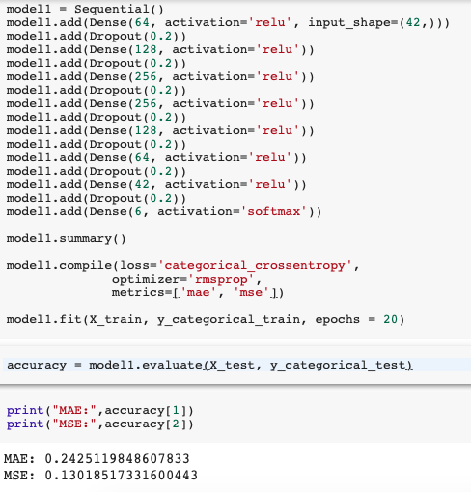
Results
‹#›
Date: 07-07-2019
Group No: 76

Slide 20
References
‹#›
[1] Gediminas Adomavicius, Member, IEEE, and Alexander Tuzhilin, Member, IEEE “Toward the Next Generation of Recommender Systems: A Survey of the State-of-the-Art and Possible Extensions” (2005)
[2] Yehuda Koren ,Robert Bell ,Chris Volinsky“Matrix Factorization Techniques for Recommender Systems” (2009)
[3]Miguel Á.García-Cumbreras,Arturo Montejo-Ráez,Manuel C.Díaz-Galiano “Pessimists and optimists: Improving collaborative filtering through sentiment analysis”(2013)
[4]JianWei JianhuaHe KaiChen YiZhou ZuoyinTang “Collaborative filtering and deep learning based recommendation system for cold start items”(2016)
Date: 07-07-2019
Group No: 76

